Slide 1

Disease Prediction Based on Symptoms
using Machine Learning

Slide 2
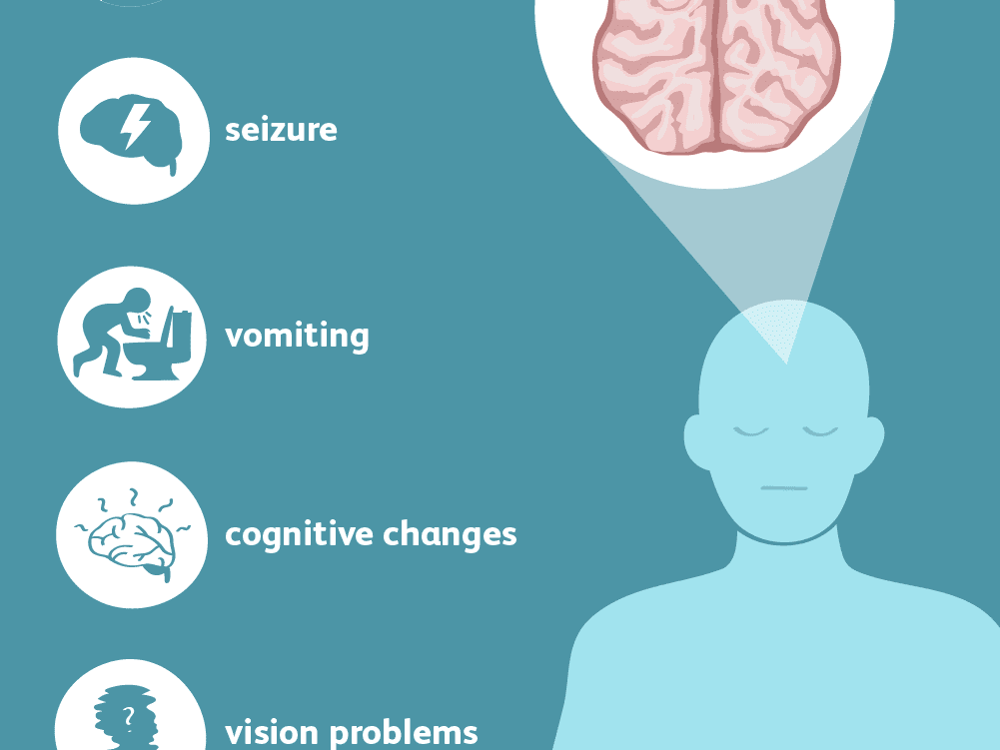

Slide 3
Agenda
Problem Title
Problem Statement
Abstract
Solution
Impact on society

Slide 4
Problem Statement
The goal of this project is early detection and lifestyle changes or surveillance, to reduce the risk of disease, or to detect it early enough to treat it most effectively.

Slide 5
Abstract
The healthcare domain is one of the prominent research fields in the current scenario with the rapid improvement of technology and data. It is difficult to handle the huge amount of data of the patients. It is easier to handle this data through Big Data Analytics. There are a lot of procedures for the treatment of multiple diseases across the world. Machine Learning is an emerging approach that helps in prediction, Diagnosis of a disease. This project depicts the prediction of disease based on symptoms using machine learning. Machine Learning algorithm Random Forest are employed on the dataset and predict the disease. We also store the predicted disease and the symptoms on the database. Its implementation is done through the python programming language. We will predict the disease based on the accuracy of the algorithm. The accuracy of an algorithm is determined by the performance on the given dataset.

Slide 6
Solution
There are a lot of procedures for the treatment of multiple diseases across the world. Machine Learning is an emerging approach that helps in prediction, Diagnosis of a disease.
This project depicts the prediction of disease based on symptoms using machine learning.
Machine Learning algorithm Random Forest are employed on the dataset and predict the disease.
We also store the predicted disease and the symptoms on the database. Its implementation is done through the python programming language.
We will predict the disease based on the accuracy of the algorithm. The accuracy of an algorithm is determined by the performance on the given dataset

Slide 7
Impact on Society
The economic costs of infectious diseases especially such as HIV/AIDS and malaria are significant. Their increasing toll on productivity owing to deaths and chronic debilitating illnesses, reduced profitability and decreased foreign investment, has had a serious effect on the economic growth of some poor countries.
The earlier detection of disease may lead to more cures or longer survival. This possibility has led to public health programs which recommend populations to have periodic screening examinations for detecting specific chronic diseases, for example, cancer, diabetes, cardiovascular disease and so on.

